Slide 1
INTELLECTUAL PROPERTY RIGHTS(IPR)
AN OVERVIEW OF
1

Slide 2
Introduction
Intellectual Property is a property that arises from the human intellect. It is a product of human creation.
Intellectual Property is the creation of the human intellectual process and is therefore the product of the human intellect or mind.
2

Slide 3
Intellectual Property
It is an intangible form of property.
It is a personal property.
It is a basic form of property.
It is based on information.
3

Slide 4
Definition of Intellectual Property
“Intellectual Property shall include the rights relating to
literary, artistic and scientific works,
performances of performing artists, phonograms, and broadcasts,
inventions in all fields of human endeavor
scientific discoveries
Industrial designs
trademarks, service marks and commercial names and designations
protection against unfair competition
and all other rights resulting from intellectual activity in the industrial, scientific, literary or artistic fields.”
(WIPO Convention)
4

Slide 5
Nature of Intellectual Property
Creation of human mind (Intellect)
Intangible property
Exclusive rights given by statutes
Attended with limitations and exceptions
Time-bound
Territorial
5

Slide 6
International Treaties
Paris Convention for the Protection of Industrial Property 1883
Berne Convention for the Protection of Literary and Artistic Works 1886
International Union for New Varieties of Plants (UPOV) 1961, 1972, 1978 and 1991
Convention on Biodiversity, 1992
Agreement on Trade Related Aspects of Intellectual Property Rights 1994
Internet Treaties 1996
6

Slide 7
IP as a Property
Can be sold
Can be bought
Can be lease or rent
Can pass under a will
Can be assigned
7

Slide 8
IP Laws of India
Act | Ministry/Department
The Copyright Act, 1957 | Higher Education
The Patents Act, 1970 | Industrial Policy & Promotion
The Designs Act, 2000 | Industrial Policy & Promotion
The Trade Marks Act, 1999 | Industrial Policy & Promotion
The Geographical Indications of Goods (Registration and Protection) Act, 1999 | Industrial Policy & Promotion
The Semiconductor Integrated Circuits Layout- Design Act, 2000 | Information Technology
The Protection of Plant Varieties and Farmers’ Rights Act, 2001 | Agriculture and Cooperation
8

Slide 9
Intellectual property (IP) is a term referring to a brand, invention, design or other kind of creation, which a person or business has legal rights over. Almost all businesses own some form of IP, which could be a business asset.
Common types of IP include:
Copyright – this protects written or published works such as books, songs, films, web content and artistic works;
Patents – this protects commercial inventions, for example, a new business product or process;
Designs – this protects designs, such as drawings or computer models;
Trade marks – this protects signs, symbols, logos, words or sounds that distinguish your products and services from those of
your competitors.
9

Slide 10
INTELLECTUAL PROPERTY RIGHTS (IPRs)
PROPERTY
Tangible
Intangible
Movable eg : Car |  |  | Immovable eg: Building
Intellectual Property
Industrial Property Related
Copyright Related
Patents, Designs, Trademarks, GIs
10

Slide 11

INTELLECTUAL PROPERTY RIGHTS (IPRs)
Patents
Trademarks
Copy Rights
IPR
Geographical
Indications
Industrial Design
Exclusive rights given to person over the creation of their minds for certain periods of time
Legal right
Intangible potential asset
Monopoly
Negative rights i.e., it prevents others to use his/her creation for a definite time
11

Slide 12
IP can be either registered or unregistered.
With unregistered IP, you automatically have legal rights over your creation. Unregistered forms of IP include copyright, unregistered design rights, common law trade marks and database rights, confidential information and trade secrets.
With registered IP, you will have to apply to an authority, such as the Intellectual Property Office in the UK, to have your rights recognised. If you do not do this, others are free to exploit your creations. Registered forms of IP include patents, registered trade marks and registered design rights. Copyright is also registerable.
12

Slide 13
INTELLECTUAL PROPERTY RIGHTS (IPRs)
The intellectual property rights were essentially recognized and accepted all over the world due to some very important reasons.
To provide an incentive to individuals for new creations
To accord due recognition to the creators and inventors
To ensure material reward for intellectual property
To make available genuine and original products.
13

Slide 14
VARIOUS KINDS OF IPRS
Patents:
Inventions (Products, Processes, Materials, Compositions)
Technical Solution to a Technical problem
Industrial Designs:
External features appealing to the eye
New Shape, Pattern or Configuration Trade
Marks:
A visual symbol such as a Word, Name, Logo, Label, Monogram, Slogan etc.
Applied on Article of Manufacture or Service
Indicates the origin of goods and services
14

Slide 15
VARIOUS KINDS OF IPRS
Copyrights:
Artistic, literary, musical and dramatic creations
Proprietary right
Comes into existence as soon as the work is created
Geographical Indications (GIs):
Identifies agricultural, natural or manufactured goods originating from a definite territory in India
Possessing special quality or reputation based
upon unique location
characteristics of the geographical
15

Slide 16

















ORGANIZATION STRUCTURE
Ministry of Commerce & Industry Dept. Of Industrial Policy & Promotion
Controller General of Patents, Designs & Trade Marks
Patent & Design
Office
Trade Marks
Registry
Geographical Indications Registry
Patent Information System
Kolkata
Mumbai
Chennai
RGNIIPM
Kolkata
Delhi
Delhi
Mumbai
Chennai
NAGPUR
Chennai
Ahmadabad

Slide 17
VALIDITY OF IPR
Sr No. | IPR | Maximum Protection | Renewal | Act/Rule
1 | Patent | 20 Yrs | *Every year (mandatory) | The Patents Act,1970 Amended in 2005
2 | Trade Mark | Life long | After 10yrs | The Trade Marks Act, 1999 Amended in 2010
3 | Design | 15 Yrs | After 10 years for next 5 years | The Designs Act, 2000 & Designs (Amendment) Rules, 2014
4 | Copyright | 60 years | Not require | The Copyright Act, 1957 Amended in 2012
5 | Geographical Indication (GI) | Life long | After 10 Yrs | The Geographical Indications of Goods (Registration and Protection) Act, 1999
*Patents will cease and be transferred to public domain if Patents are not renewed within 6 month of expiry of concerned year by paying renewal fee.

Slide 18

RELATION BETWEEN IPRs
The logo Coca-Cola is an example for
TRADE MARK.
Shape of the bottle – an INDUSTRIAL DESIGN.
PATENTmay have been obtained in respect of bottling equipment.
COPYRIGHT – in respect of the text, database or artistic work appearing on its website.
i.e., A single product can be
protected by more than one IPR.

Slide 19
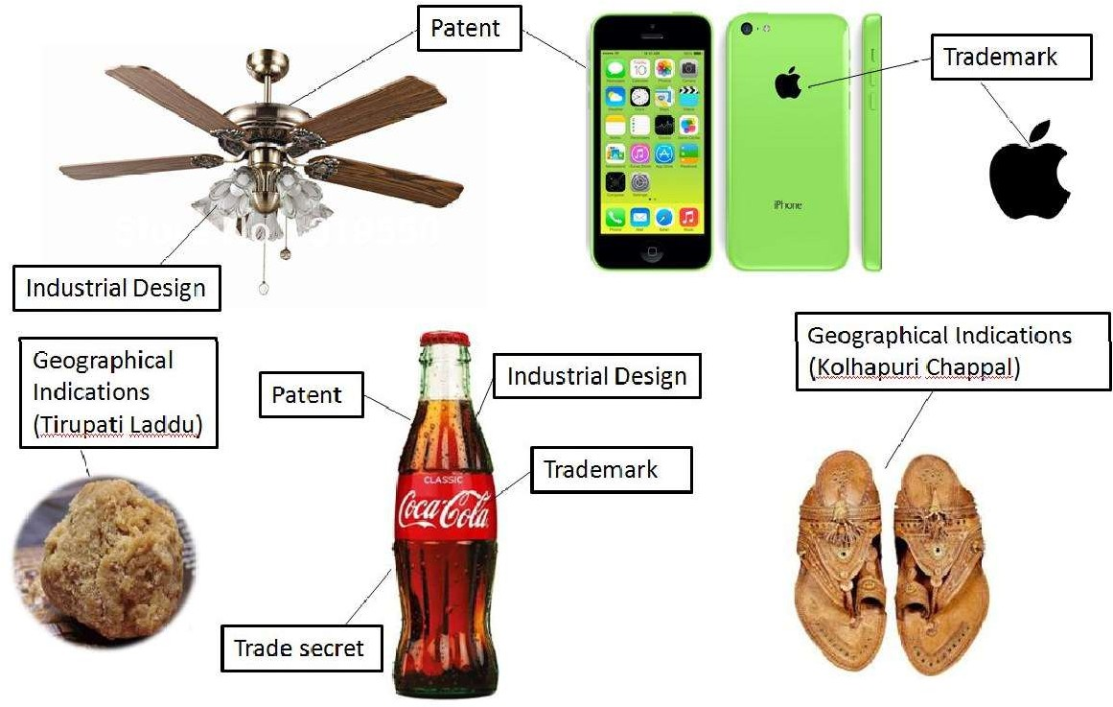
INTRODUCTION TO IPR

Slide 20
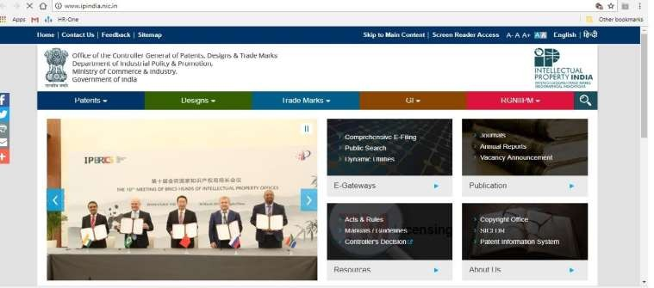
PATENTS
It is the exclusive right of inventor to prevent others from possessing, using, selling, manufacturing and importing the patented invention or offering to do any of these with in a definite geographical area.
Patents have territorial jurisdiction i.e., we have to register the patents in all countries where we have our interests.
Patent application can be filed online in India by inventor or his assignee on www.ipindia.nic.in

Slide 21
PATENTS
Patent is an exclusive monopoly right:
Granted by Government of India
For an Invention
To the Inventor or his Assignee
As a Territorial Right
In lieu of Disclosure of invention to the Government
Term of Patent: 20 years from date of filing

Slide 22
PATENT ACT & RULES
In India, Patent rights are governed by the Patents Act, At present 3rd amendment of Act known as the
Government, which are known as “Patent Rules, 2003”,
(Amendment) Act, 2005 is in force.
For application of Patents Act.
now Patent (Amendment) Rule, 2006 and further
Sept’2015 are in force.
For better understanding of Act & Rules, “Draft Manual of Patent Practice & Procedure (MPPP), 2008” is made by the patent office.
There are 4 patent offices in India having work distribution according to their geographical location viz. Kolkata, Delhi, Mumbai & Chennai

Slide 23
PATENT ACT & RULES
Criteria of Patentability:
Novelty
Inventive step or it must be non-obvious
Capable of industrial application
Not fall within the provision of section 3 & 4 of the Patents Act
1970
Patents Act 1970:
Section3: List which are not inventions
Frivolous or obvious
Contrary to well established natural laws
Injurious to Public Health
Mere arrangement or re-arrangement,
Discovery of Scientific principle
Discovery of living thing or non-living substances in nature
Method of agriculture or horticulture
A mathematical or business method or a computer program
Section4: Not-patentable: Atomic Energy related

Slide 24
INDUSTRIAL DESIGN
Ornamental or aesthetic aspect of a useful article of industry.
Aspect that gives special appearance
Aspect which differentiates from current products Only the
aesthetic/visual form of a product
not the Technical (Patents)
nor Distinguishing Features (Trade Marks)
The ornamental or aesthetic aspects of an article consist of:
Three dimensional features, such as the shape, surface or texture of
an article or
Two dimensional features, such as patterns, lines or colours.
Design makes the product attractive and appealing to the consumers and adds
to its commercial value for that reason.
24

Slide 25
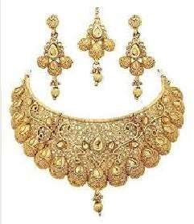
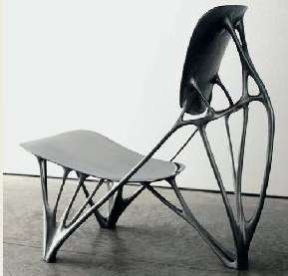

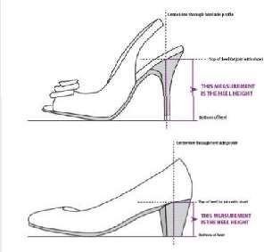


INDUSTRIAL DESIGN
Exclusive right against unauthorized copying
Protection normally lasts for an initial ten years, after which it can usually be renewed for, in most cases, up to 15 years.
Promotes more innovative and aesthetically attractive products
25

Slide 26
TRADEMARKS
Generally “Brand” or “Logo”
A visual symbol which may be word signature, name, device, label, numerals or combination of colors used by one undertaking on goods or services or other articles of commerce to distinguish it from other similar goods or services originating from a different undertaking
Any Name which is not unusual for trade to adopt as mark
Device or Symbol or Monogram
Shape of goods or their packing
Combination of colors or even a single color in
combination with word or device
26

Slide 27

TRADEMARKS

Slide 28
Copyrights
Copyright is a legal term describing rights given to creators for their literary and artistic works
The works covered by Copyright include :
literary works such as novels, poems, plays, reference works, newspapers and articles
computer programs and databases
films, musical compositions, dance & theatrical productions
artistic works such as paintings, drawings, photographs and sculptures
architecture, advertisements, maps, technical drawings and manuals.
Copyright comes into existence as soon as the work is created and protects skill & labour employed by the creator in production of his work.

Slide 29
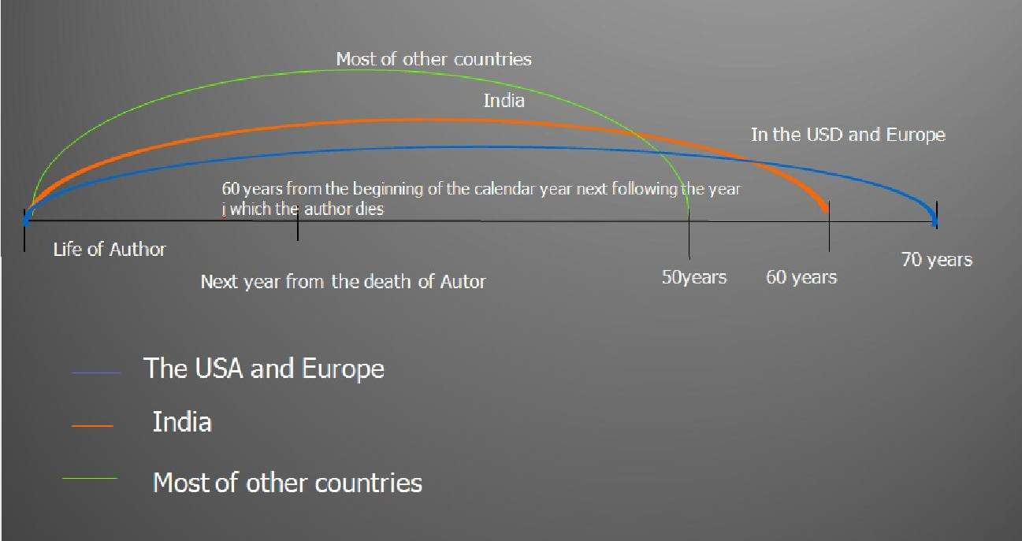
TERM OF COPYRIGHT
29

Slide 30
GEOGRAPHICAL INDICATIONS
GIs identify agricultural, natural or manufactured goods associated with a territory/region/locality. GI gives protection to the group of people or associations involved in the production of the product using traditional skills and knowledge
The manufactured goods should be produced or processed or prepared in that territory. This gives a special quality to the product due to geographical/climatic environment, reputation, specific manufacturing/farming skills, traditions and other characteristics attributable to origin.
It consists of the name of the place of origin & originates from a definite geographical territory.
Darjeeling Tea, Kancheepuram Saree, Kolhapuri Chappals, Tirupati Laddu, Nagpur Orange etc.

Slide 31
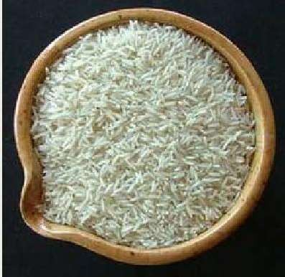




GEOGRAPHICAL INDICATIONS
Examples of Indian Geographical Indications:
Basmati Rice
Darjeeling Tea
Kanchipuram Silk Saree
Alphonso Mango
Nagpur Orange
Kolhapuri Chappal
Bikaneri Bhujia
Agra Petha

Slide 32

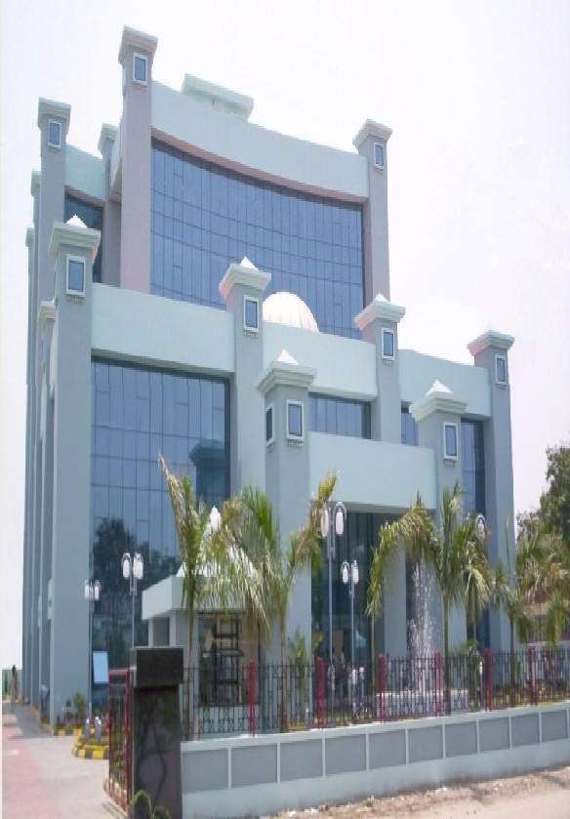
PATENT OFFICE- MUMBAI
The Patent Office, Government of India, Boudhik Sampada Bhavan, Near Antop Hill Post Office, S.M.Road,Antop Hill, Mumbai – 400 037
Phone: (91)(22) 24137701
Fax: (91)(22) 24130387
Email: mumbai-patent@nic.in
The States of Gujarat, Maharashtra, Madhya Pradesh, Goa and Chhattisgarh and the UTs of Daman & Diu and Dadra & Nagar Haveli

Slide 33

PATENT OFFICE - CHENNAI
The Patent Office, Government of India, Intellectual Property Rights Building,
G.S.T. Road, Guindy, Chennai – 600 032.
Phone: (91)(44) 2250 2081-84
Fax: (91)(44) 2250 2066
Email: chennai-patent@nic.in
The States of Andhra Pradesh, Telengana, Karnataka, Kerala, Tamil Nadu and the UTs of Pondicherry and Lakshadweep.

Slide 34
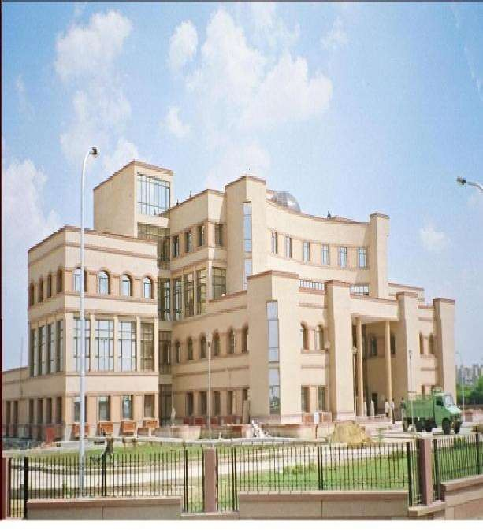
PATENT OFFICE NEW DELHI
The Patent Office, Boudhik Sampada Bhavan,
Plot No. 32., Sector-14, Dwarka, New Delhi – 1 0075
Phone: (91)(11) 2808 1921 – 25
Email: delhi-patent@nic.in
The States of Haryana, Himachal Pradesh, Punjab, Rajasthan, Uttar Pradesh, Uttaranchal, Delhi and the UTs of Chandigarh, Jammu & Kashmir and Ladakh

Slide 35
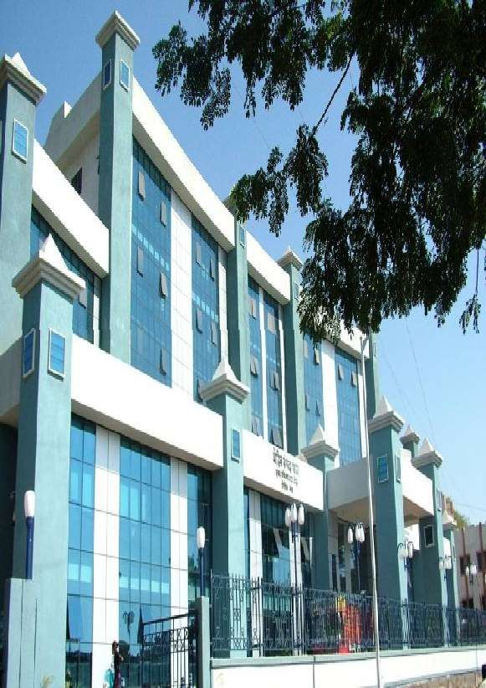
PATENT OFFICE - KOLKATA
The Patent Office (Head Office), Boudhik Sampada Bhavan,
CP-2, Sector –V, Salt Lake City,
Kolkata- 700 091
Phone: (91)(33) 2367 1943
/44/45/46/87
Fax: (91)(33) 2367 1988
Email: kolkata-patent@nic.in
Rest of India
35

Slide 36
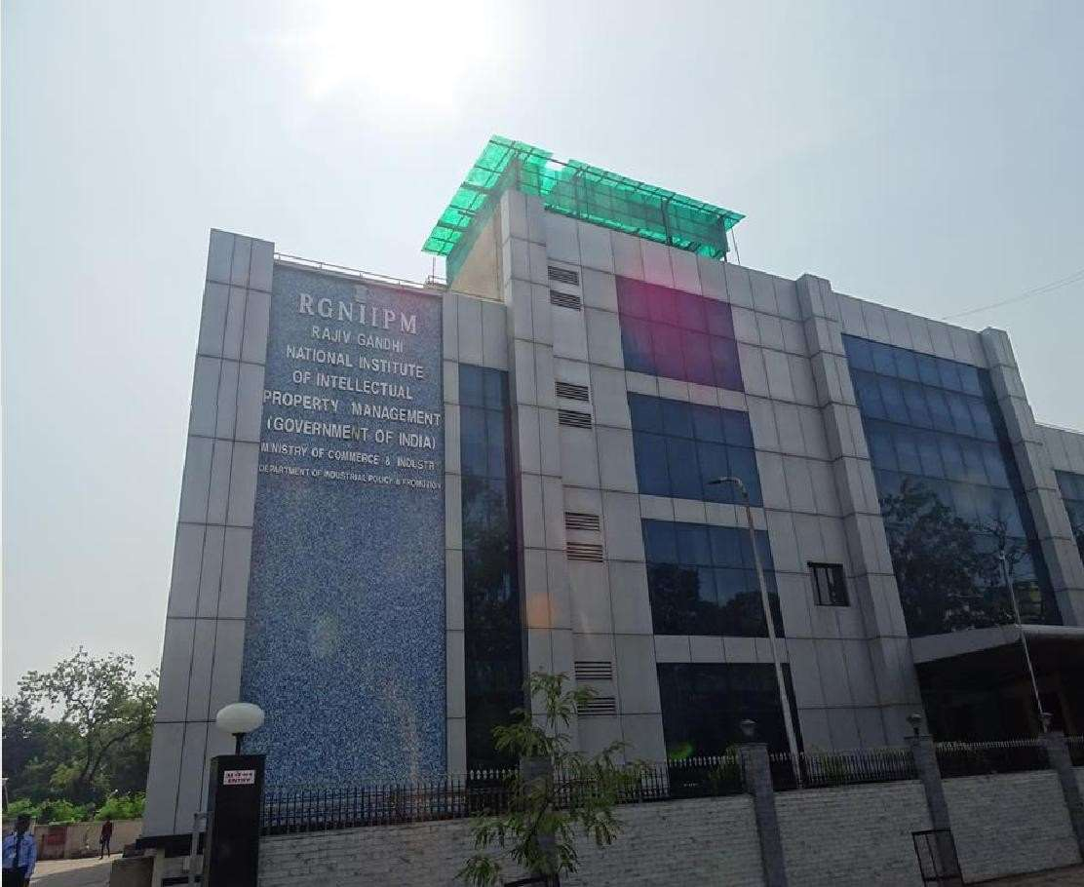
RGNIIPM - NAGPUR

Slide 37
International Organizations in IP
World Intellectual Property Organization
World Trade Organization

Slide 38

39

